Slide 1
PLM Package in R
On Rossmann store sales - PANEL data analysis
Presented by – Random R
ashish Gupta
Krishna muddodi
nachiket Garge
Pramod Kotla
rajit podder

Slide 2
Agenda
Introduction
Exploratory Analysis
Panel Data Models
Panel Data Estimators
R Code And Results

Slide 3
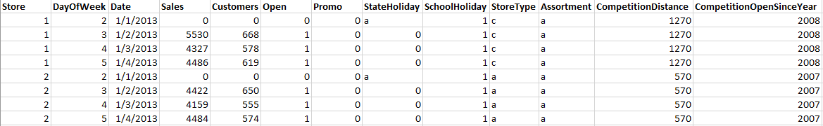
Panel Data
In statistics and econometrics, the term panel data refers to multi-dimensional data frequently involving measurements over time.
Behavior of entities such as firms or individuals observed across time.
Cross-sectional and time series data.
Notes:
Panel data (also known as longitudinal or cross- sectional time-series data) is a dataset in which the behavior of entities are observed across time.
These entities could be states, companies, individuals, countries, etc. In statistics and econometrics, the term panel data refers to multi-dimensional data frequently involving measurements over time.
Panel data contain observations of multiple phenomena obtained over multiple time periods for the same firms or individuals.
Cross-sectional and time series data.

Slide 4
Sales Data
1,115 Rossmann stores
Over a period of (01-01-2013 to 07-31-2015)
1,017,209 observations.
Store related data like Store Establishment Year, Assortment etc. and sales data over time for different stores are given.

Slide 5
Type of Regressors in Panel Data
Varying Regressor : X_{it}
Time-Invariant Regressor : X_{it} = X_{i} for all t
Individual-Invariant Regressor : X_{it} = X_{t} for all i
Notes:
Varying regressor X_{it} – These are the regressors which depend on both i (in this case store) and time. e.g. Number of customers – They vary with time for the same stores that is they show within group variability. Also they show between group variability i.e. the value for customers in different stores for same time is different.
Time-invariant regressors X_{it} = X_{i} for all t – These are regressors which are time independent e.g. In this case all attributes corresponding to stores like Assortment type, Store type, Competition Distance and Competition Open Since Year all are time invariant. These variables have within group variation equals to 0 i.e. for the same store they don’t change over time.
Individual-Invariant Regressors X_{it} = X_{t} for all i – These variables do not depend on individual ids (in this case stores), they depend only on time, i.e. these variables have within group variation for a given time equals to 0. e.g. School Holiday, State Holiday depends on the date but not on individual store.

Slide 6
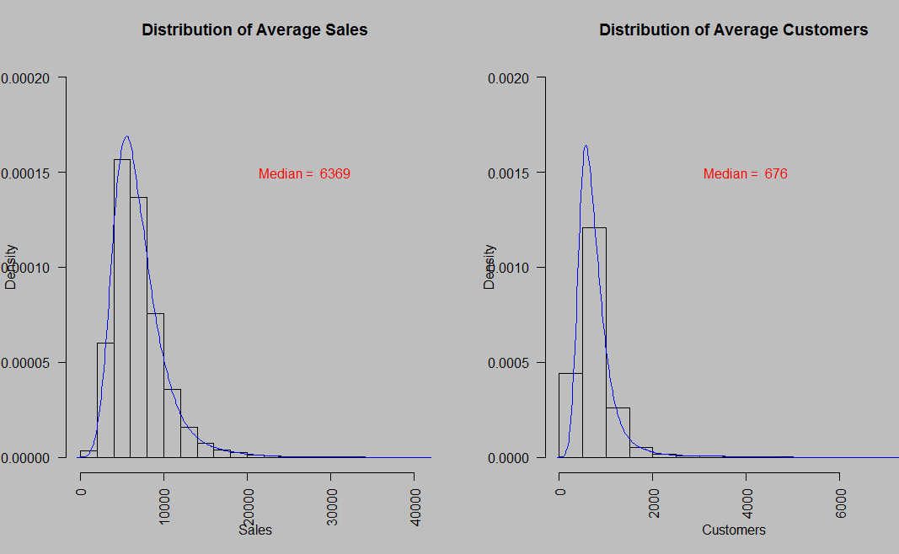
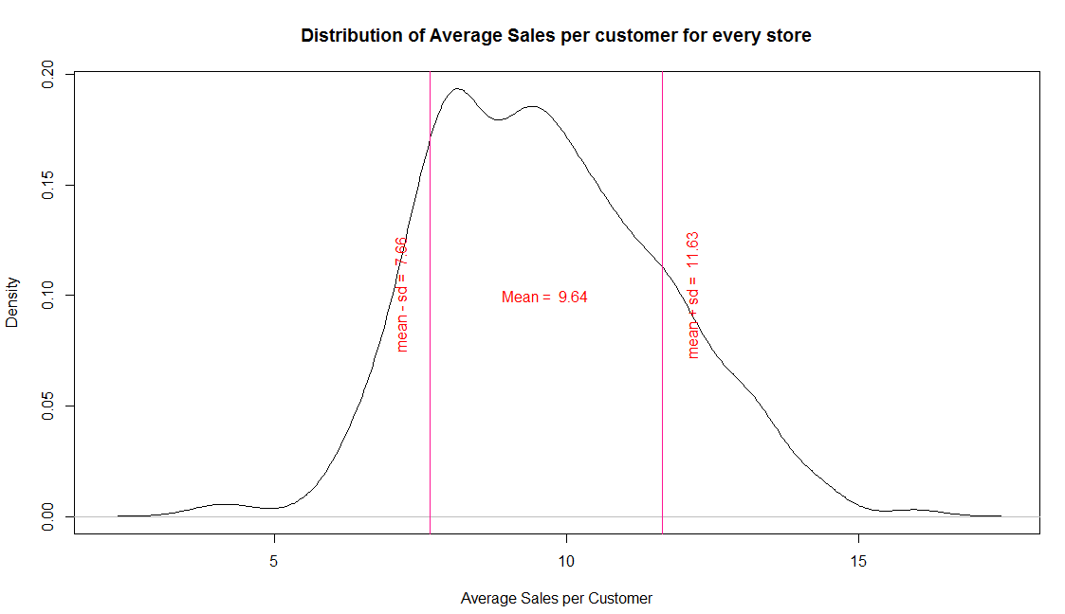
Distribution of Sales and Customers

Slide 7
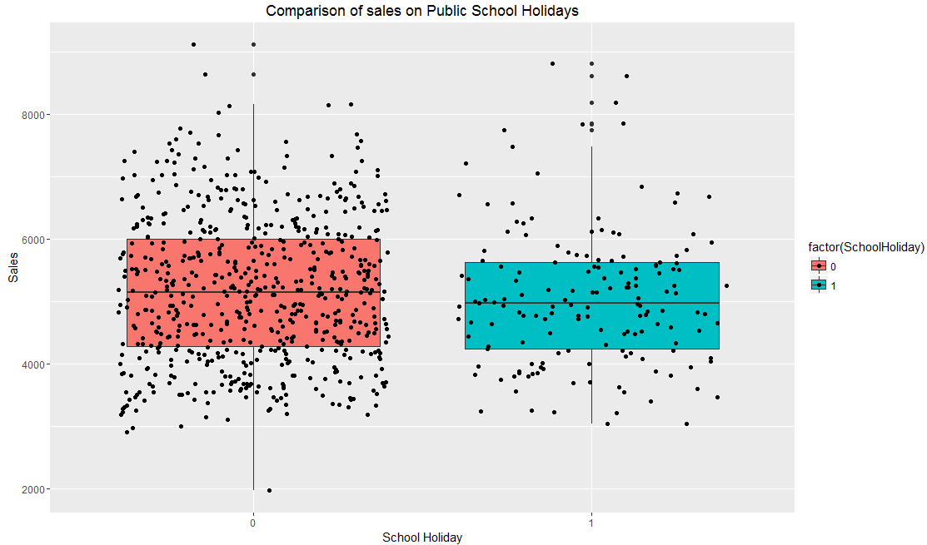
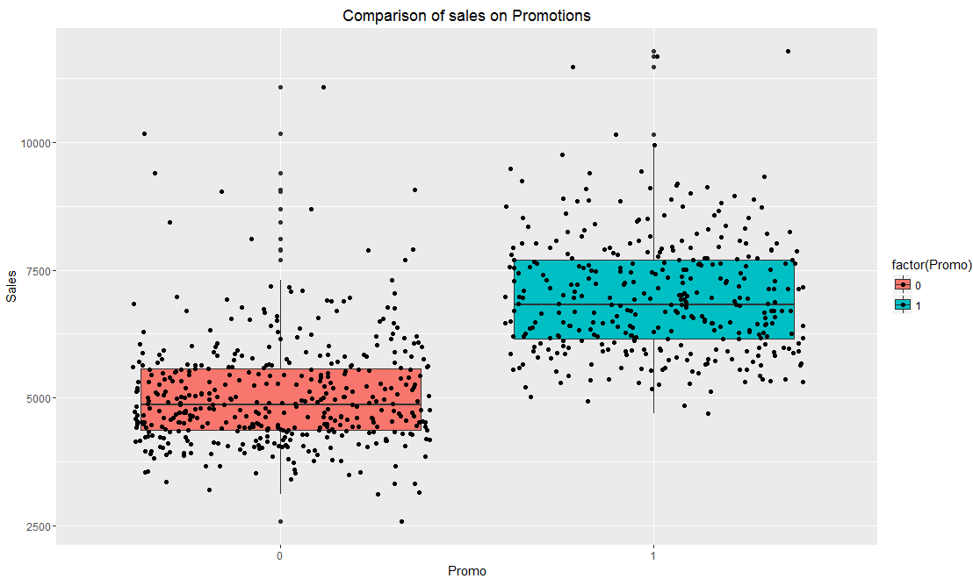
Sales with Holidays and Promotion

Slide 8
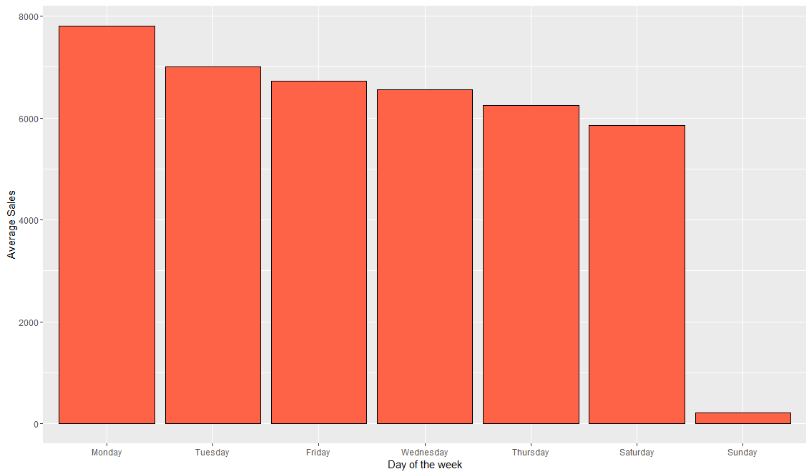
Average Sales Over Day of Week

Slide 9
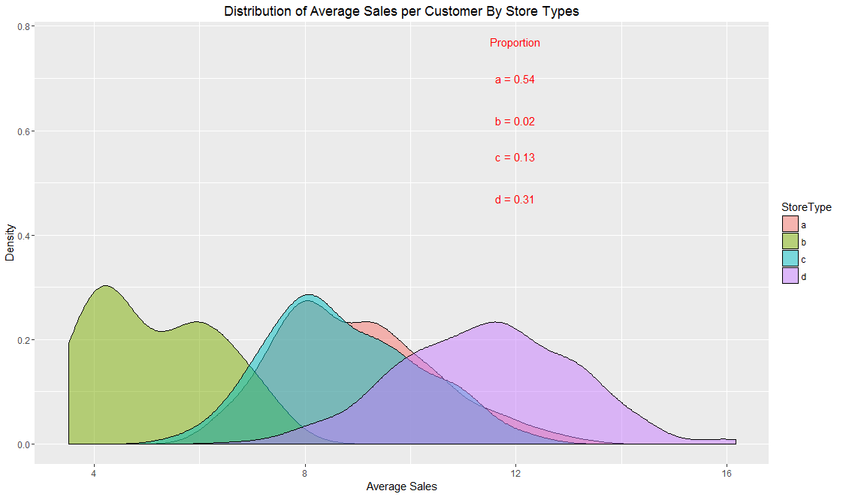
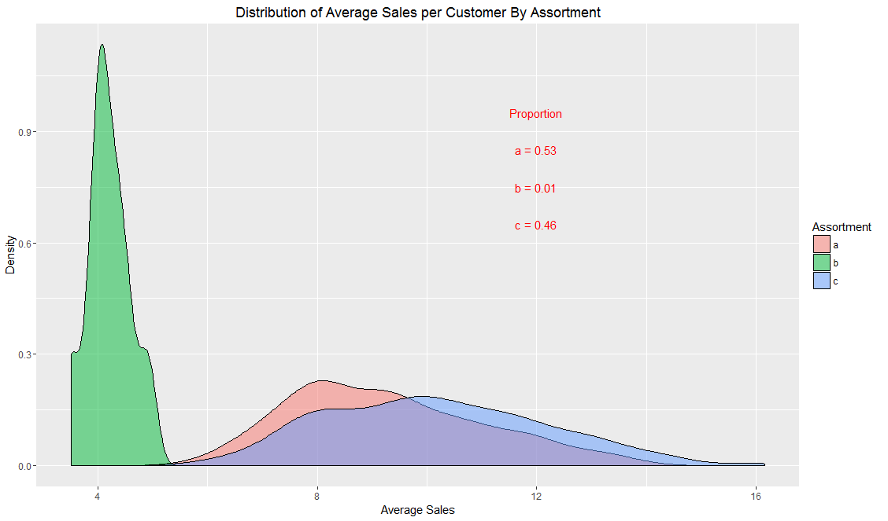
Distribution of Average Sales/Customer by Store Type and Assortment

Slide 10

Panel data regression over Linear regression
Assumptions of Linear regression don’t hold good since the OLS estimates are BIASED and/or INEFFICIENT.
Biased - Expected value of parameter estimate is different from true
Inefficient - Estimator is less accurate as sample size increases than an alternative estimator
Suppose we have a model with an unobserved, time-constant variable c:
Notes:
Assumptions of linear regression are:
Mean of response variable is linearly related to predictor variables
Error terms are normally distributed
Errors have equal variance (homoscedastic)
Errors are independent at each predictor value

Slide 11
Panel data regression over Linear regression
The error term consists of two components, an “idiosyncratic” component u and an “unobserved heterogeneity” component c.
Unobserved heterogeneity
Fixed and Random panel models address the issues related to “unobserved heterogeneity”
Notes:
The error term consists of two components, an “idiosyncratic” component u and an “unobserved heterogeneity” component c.
If the unobserved heterogeneity i.e. c is correlated with one or more of the explanatory variables, OLS parameter estimates are biased and inconsistent.
If we have more than one observation on any unit, the errors will be correlated and OLS estimates will be inefficient
Using fixed and random panel models (explained later) addresses the issues related to “unobserved heterogeneity” and thus we use panel modelling techniques over simple linear regression.
- OLS(Ordinary Least Squares) parameter estimates are biased and inconsistent.

Slide 12
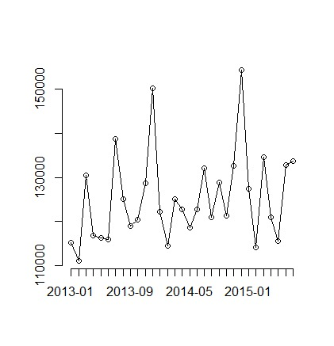
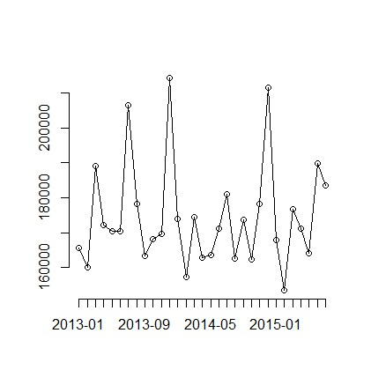
Unobserved Heterogeneity
STORE - 2
STORE - 3

Slide 13
Advantages of panel data:
Takes heterogeneity into account
Explains more variability and more efficient
Better suited to study the dynamics of change
Enables to study more complicated behavioral models
Minimizes the biases involved
Notes:
Since panel data relate to individuals, firms, states, countries, etc., over time, there is bound to be heterogeneity in these units. The techniques of panel data estimation can take such heterogeneity explicitly into account by allowing for individual-specific variables, such as individuals, firms, states, and countries.
By combining time series of cross-section observations, panel data give “more informative data, more variability, less collinearity among variables, more degrees of freedom and more efficiency.
By studying the repeated cross section of observations, panel data are better suited to study the dynamics of change. Spells of unemployment, job turnover, and labor mobility are better studied with panel data.
successive waves of minimum wage increases in the federal and/or state minimum wages. Panel data can better detect and measure effects that simply cannot be observed in pure cross-section or pure time series data. For example, the effects of minimum wage laws onemployment and earnings can be better studied if we include
Panel data enables us to study more complicated behavioral models. For example, phenomena such as economies of scale and technological change can be better handled by panel data than by pure cross-section or pure time series data.
By making data available for several thousand units, panel data can minimize the bias that might result if we aggregate individuals or firms into broad aggregates.

Slide 14
Panel Data Models
Pooled OLS Model
Fixed Effect Model
Random Effect Model

Slide 15
Panel Data Estimators
Pooled OLS Estimator
Between Estimator
First Differences Estimator
Fixed Effects or Within Estimator
Random Effects Estimator
Notes:
Panel data models can be estimated with several estimators. The estimators differ on whether they consider between or within variation in the data.
We prefer estimators that are consistent and efficient. Different estimators used are:

Slide 16

Pooled OLS Estimator
Neglects the cross-section and time series nature of the data
The pooled OLS estimator is obtained by stacking the data over i and t into one long regression with NT observations and estimating it by OLS.
The equation for pooled estimators will be,
Notes:
Here we pool all observations together and run regression model, neglecting the cross-section and time series nature of the data. In our example, by Combining all 1,115 stores for entire 2.5 years we deny the heterogeneity or individuality of the stores. In simpler words we are assuming that all the stores are same.
Basically here we completely ignore the fact that we are using panel data. If the pooled model has uncorrelated errors, then in that case model is consistent otherwise it will not be consistent.

Slide 17

Between Estimator
Removes the time information and considers the variation of “between” individuals
In our case it’s between the stores
The equation of Between estimators is :
Notes:
In between estimation technique we average all the rows over time and thus removing all the time information we have. So it considers variation that are there only “between” the cross-sectional data, in this case between different stores.
Thus, in between estimators we have, OLS estimation of the time-averaged dependent variable on the time-averaged regressors for each individual.
This model is seldom used, as it averages out the time component, and lot of essential data is lost. We miss to model the seasonal changes. The Random Effect and pooled estimators depict the between variations along with time variations and thus are more efficient than this model.

Slide 18

Within Estimator or Fixed Effect Estimator
Uses all the rows for estimation
Uses time-demeaned variables i.e , the individual-specific deviations of variables from their time-averaged values)
Mathematically,
Limitation
time-invariant variables are dropped off and their coefficients cannot be measured
Notes:
In this method of estimating we observe the “within” group effects over time. This estimator uses all the NT rows for estimation. It uses time-demeaned variables (the individual-specific deviations of variables from their time-averaged values). So basically if we take number of customers of an individual store on a particular day and subtract it from average number of customer of that store over time, I can time-demeaned value for the number of customers for that particular store.
The limitation of this estimation technique is that,. For example, in our case store assortment type and store type are same over time for a particular store so their average value will remain same and cancel out from the equation. If there are many time-invariant variables which are critical we need to use different estimation techniques like pooled OLS or between estimation.
Taking time demeaned values removes the individual specific time invariant component alpha observed in pooled OLS estimates and thus provides better estimation.

Slide 19
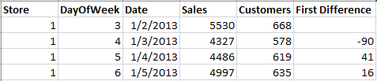
First-Differences Estimator
The first difference estimator uses the one-period changes for each individual
For example, if we have 4 rows for a store as shown below,
Mathematically,
Notes:
The first difference estimator uses the one-period changes for each individual. It uses first-differenced variables (the individual-specific one-period changes for each individual).
The first difference is null, -90, 41 and 16. That is it takes the difference of number of customers from the previous day value. This is an OLS estimation of the one-period changes of the dependent variable on the one-period changes in the regressors.
As individual specific effect alpha does not vary over time it gets cancelled out every time we subtract from previous time value. The limitation of first differences estimator is same as fixed estimators. It does not account for the variation due to time invariant variables like store type.

Slide 20
Limitations
The limitation of first differences estimator is same as fixed estimators
It does not account for the variation due to time invariant variables like store type

Slide 21
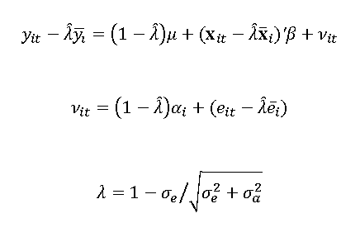
Random Effects Estimator
It is a transformed model which is combination of pooled OLS and fixed effect model. It incorporates both between variation and within variation.
Mathematically,
Notes:
We can observe the individual-specific effects alpha in the error term. As the value of lambda increase this individual effect will decrease. As lambda approaches 0, our estimation becomes a pooled OLS estimation, and as lambda approaches 1 our estimation acts like a fixed effect estimation. The random effects estimates are a weighted average of the between and within estimates. Random Effect Estimators are inconsistent when we have a fixed effect model and thus cannot be used in all cases.

Slide 22
Limitations
Random Effect Estimators are inconsistent when we have a fixed effect model

Slide 23
R Code and Results

Slide 24


Slide 25
Thank You

